Slide 1
DAV6100: A project on analyzing spill incidents in New York State
Group 7:
Lakshmikar Reddy Polamreddy
Banty Phagotra
Sandeep
Yashwanth

Slide 2
Agenda
Overview
Project Flow
Data Profile
AWS architecture
ETL process
Data visualization and deliverables
Project Milestones & Timeline
Team Responsibilities
Challenges

Slide 3




Overview
Motivation:
Accidental releases of petroleum and/or other hazardous materials occur throughout New York State. Even small releases have the potential to endanger public health and contaminate groundwater, surface water, and soils.
Project Objectives:
To identify the major sources and contributing factors for these spill occurrences
To analyze if there is any relationship between the number of spill incidents and the income of the people in those counties.
To analyze if there is any relationship between the number of spill incidents and the number of manufacturing establishments in those counties.
Data Warehouse:
Developed OLAP star schema data model for data analysis
Utilized AWS cloud services
Data sources:
DATA.NY.GOV
DATA.CENSUS.GOV
EDA and Data visualization:
Python libraries – matplotlib and seaborn
Tableau

Slide 4
Project Flow
Run queries
Report the results
Spills dataset
Income dataset
Manufacturing firm's dataset
Bus Matrix
ETL process
Create OLAP database
Data analysis
Data cleaning
Create OLTP database using AWS services
Reporting
Data sources
Data profiling
OLTP database
OLAP database
Data visualization
Bar plots
Bubble charts
Tree maps
Draw conclusions

Slide 5

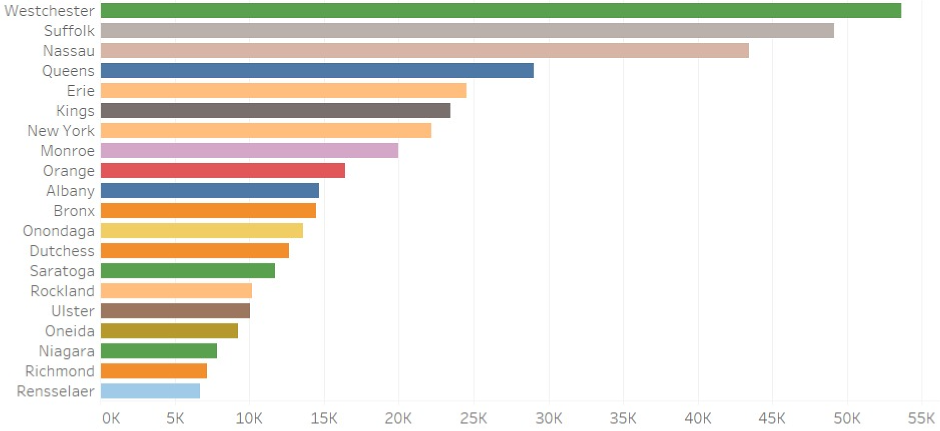
Data Profile: Spill incidents of NY
Dataset Summary
Below bar plot shows the top 20 leading counties in NY state in terms of the count of spill incidents occurred
Source of Information | https://data.ny.gov/Energy-Environment/Spill-Incidents/u44d-k5fk
Number of Records | 534K
Frequency of updates | Daily
Data type and structure | CSV
Number of columns | 20
Size | 90.6MB
Granularity | Incident level
County
Descriptive Statistics
Count of spills occurred

Slide 6

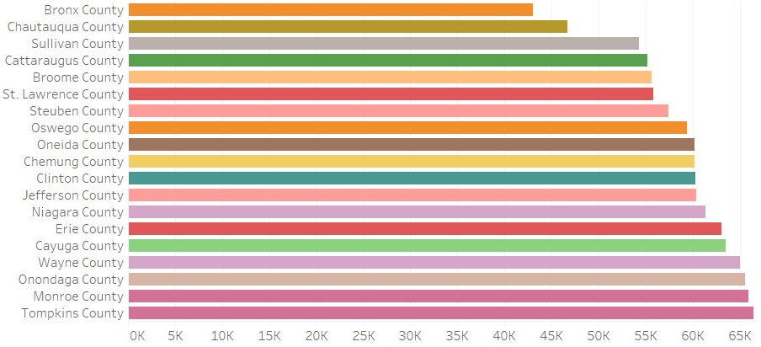
Data Profile: County-wise Income details in NY
Dataset Summary
Below bar plot shows bottom 20 counties in NY state in terms of the medium income of households
Source of Information | https://data.census.gov/table
Number of Records | 17
Frequency of updates | 5 years
Data type and structure | CSV
Number of columns | 153
Granularity | County
County
Descriptive Statistics
Median income (dollars)

Slide 7
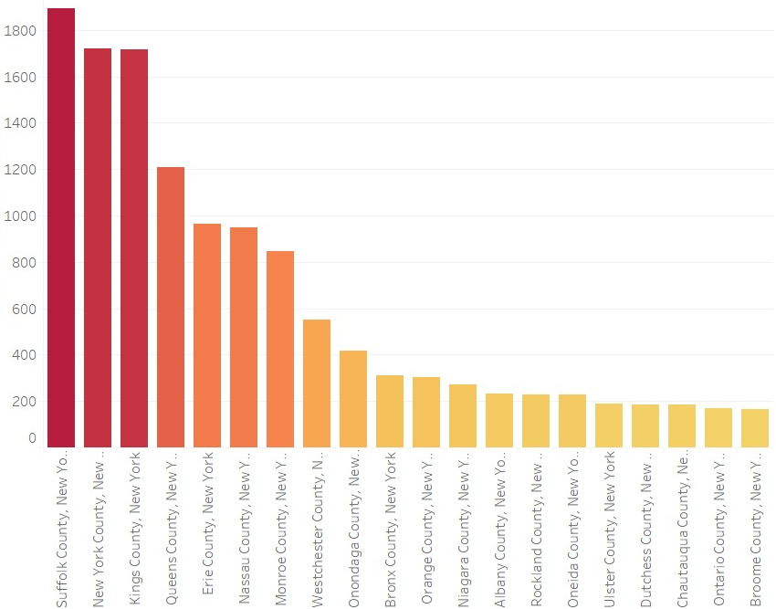
Data Profile: County-wise Manufacturing firms in NY
Dataset Summary
Below bar plot shows top 20 counties in NY state in terms of the total number of manufacturing establishments
Source of Information | https://data.census.gov/table
Number of Records | 500
Frequency of updates | 5 years
Data type and structure | CSV
Number of columns | 6
Granularity | County
Number of manufacturing establishments
Descriptive Statistics
County

Slide 8
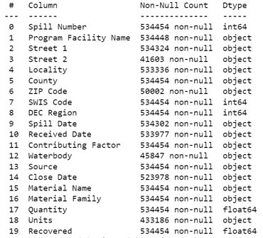
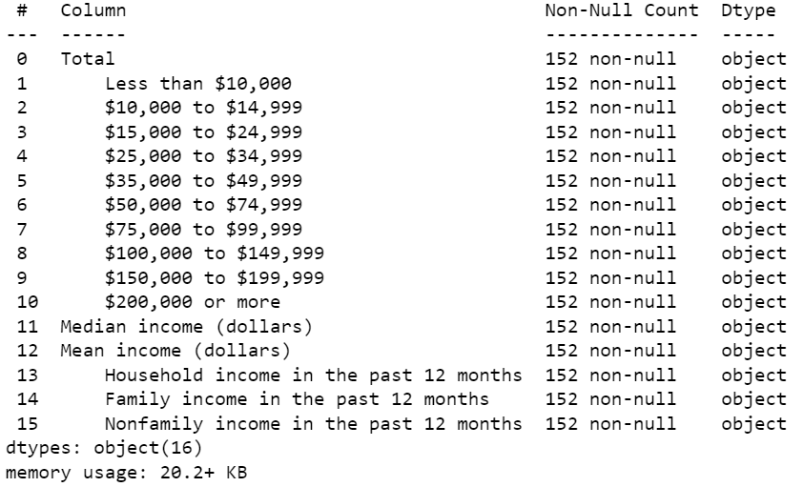
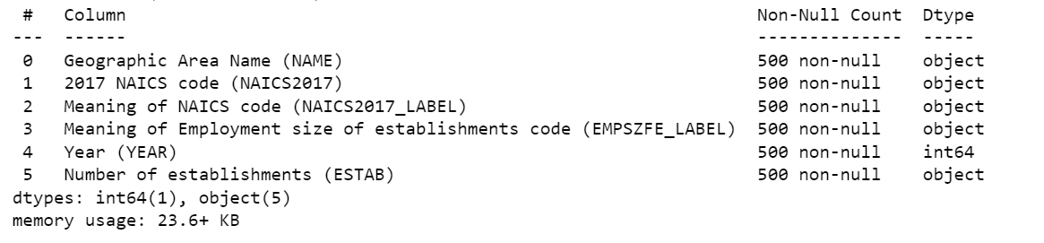
Additional information: Column details of 3 datasets
County-wise income details of NY state
Spill incidents in NY state
Manufacturing establishments of NY state

Slide 9
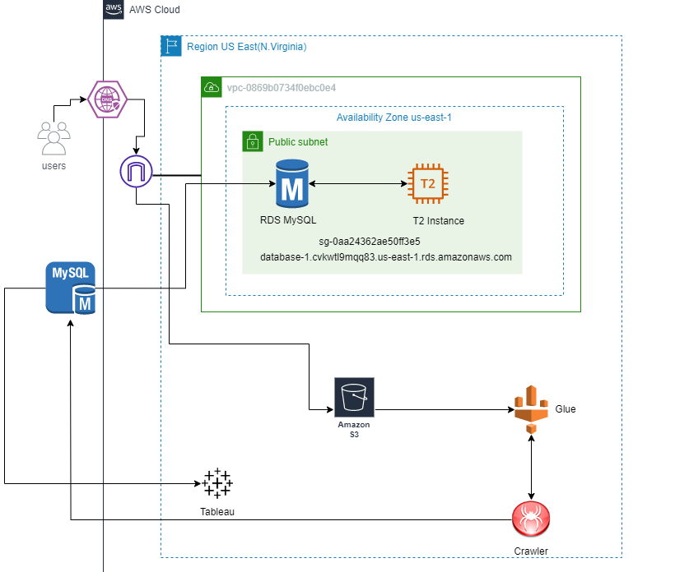
AWS Architecture

Slide 10
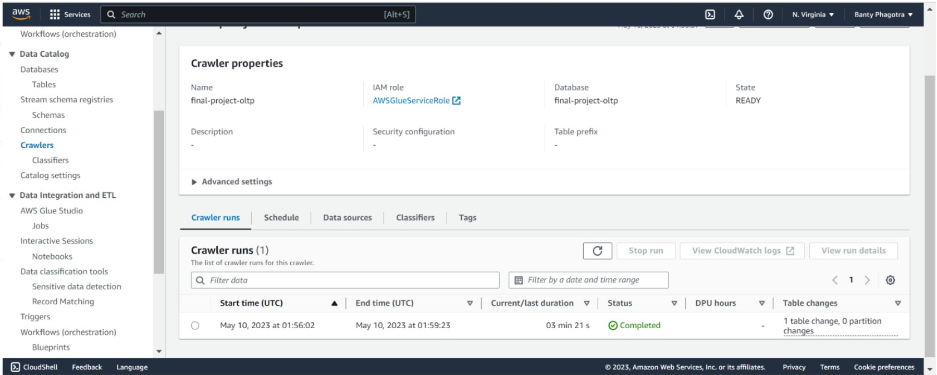
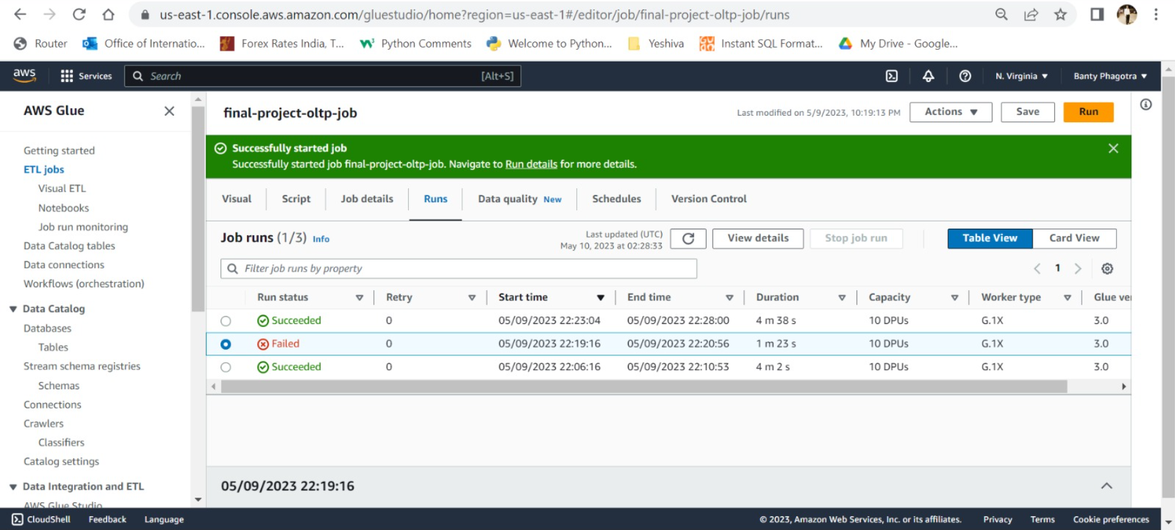
OLTP Database ETL process through AWS
AWS Crawler
AWS Glue job

Slide 11
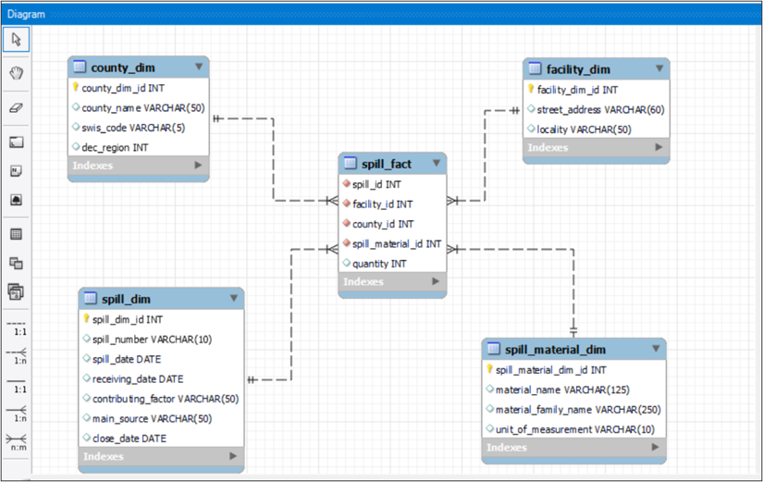
ETL process and ER Diagram
First created OLTP database using AWS services
Then created OLAP database
Star schema using surrogate keys
4 Dimension tables
1 Fact table
Created stored procedures and triggers

Slide 12
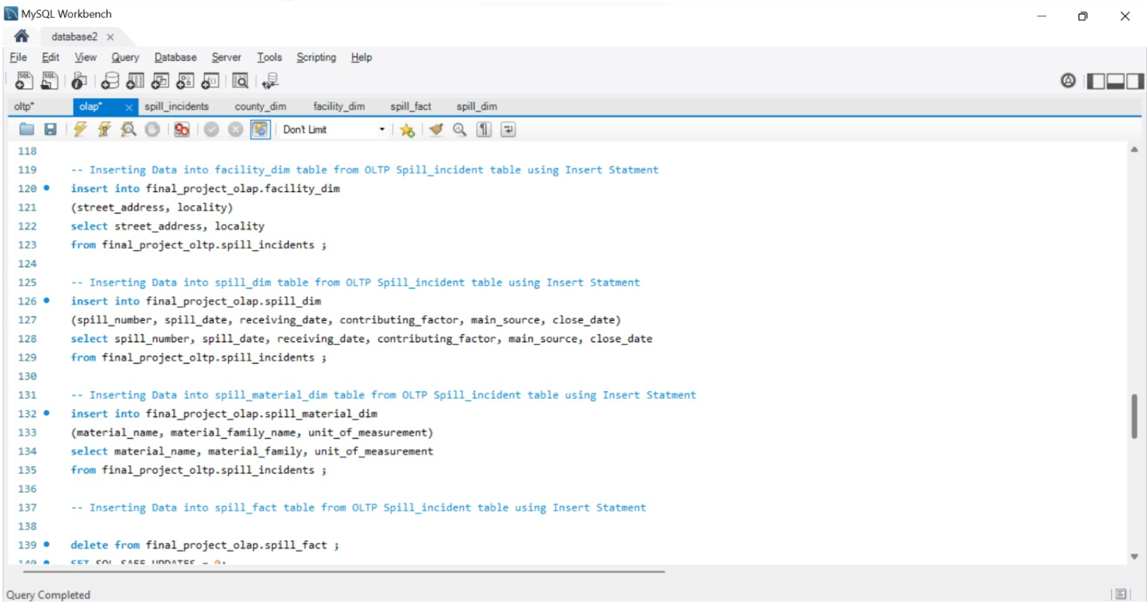
ETL process for OLAP
Insert statements sample

Slide 13
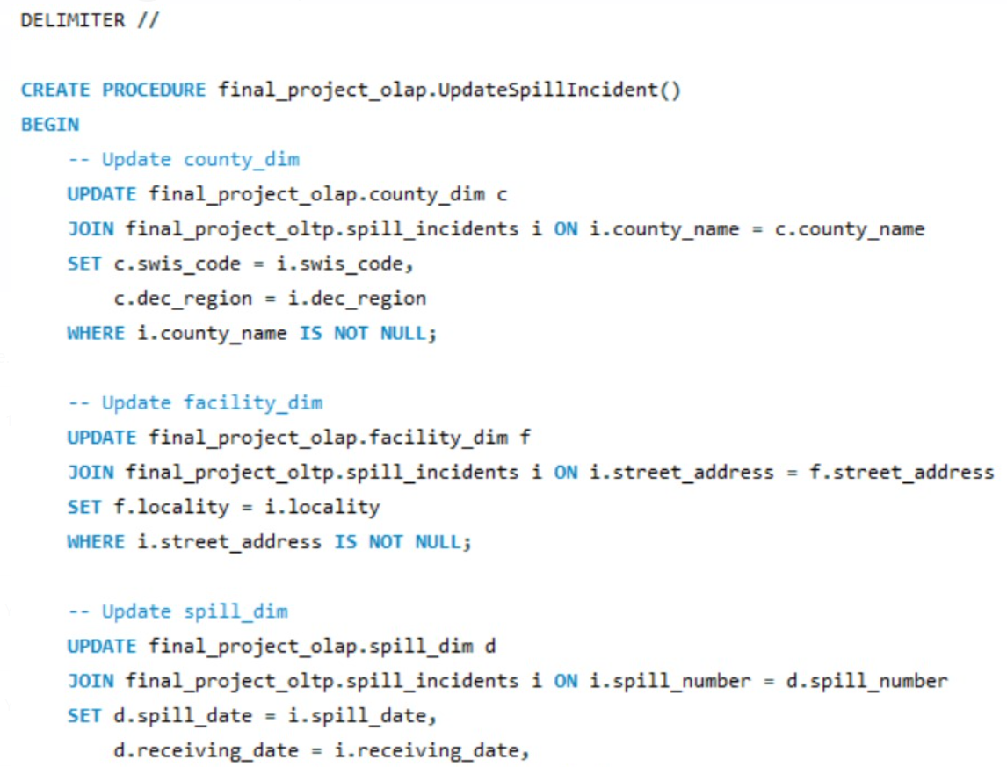
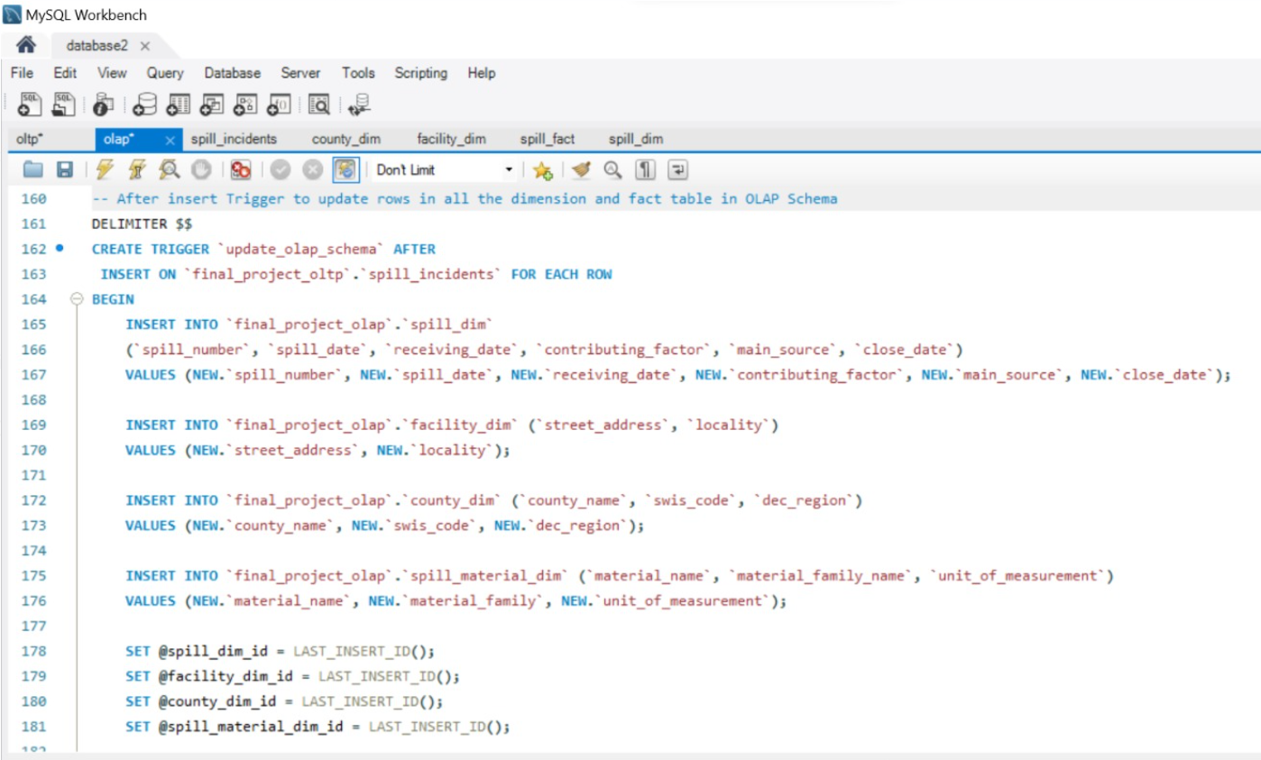
Stored procedure and Triggers
Stored procedure sample
Trigger sample

Slide 14
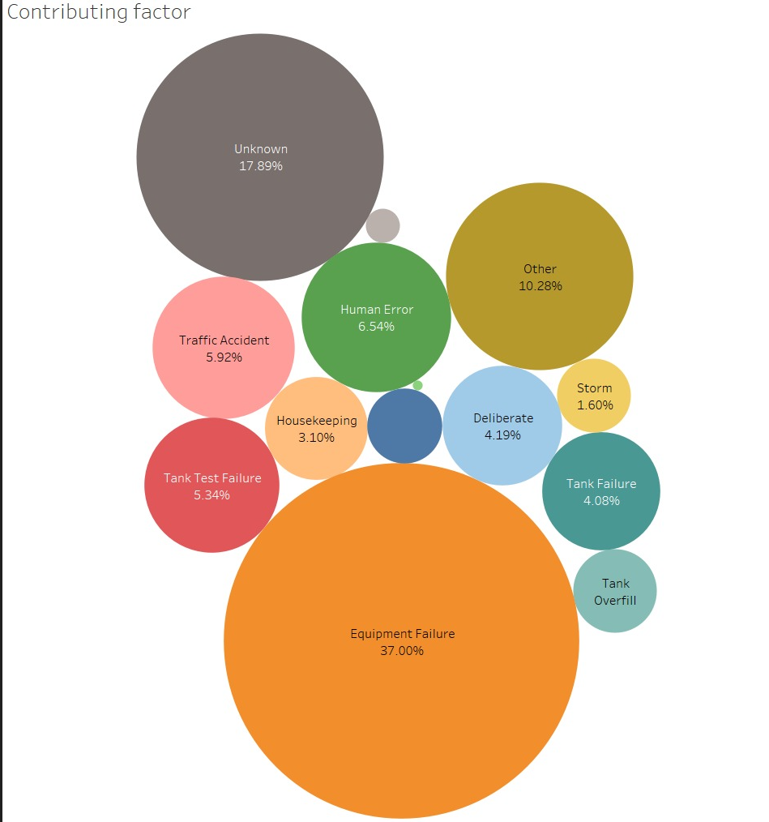
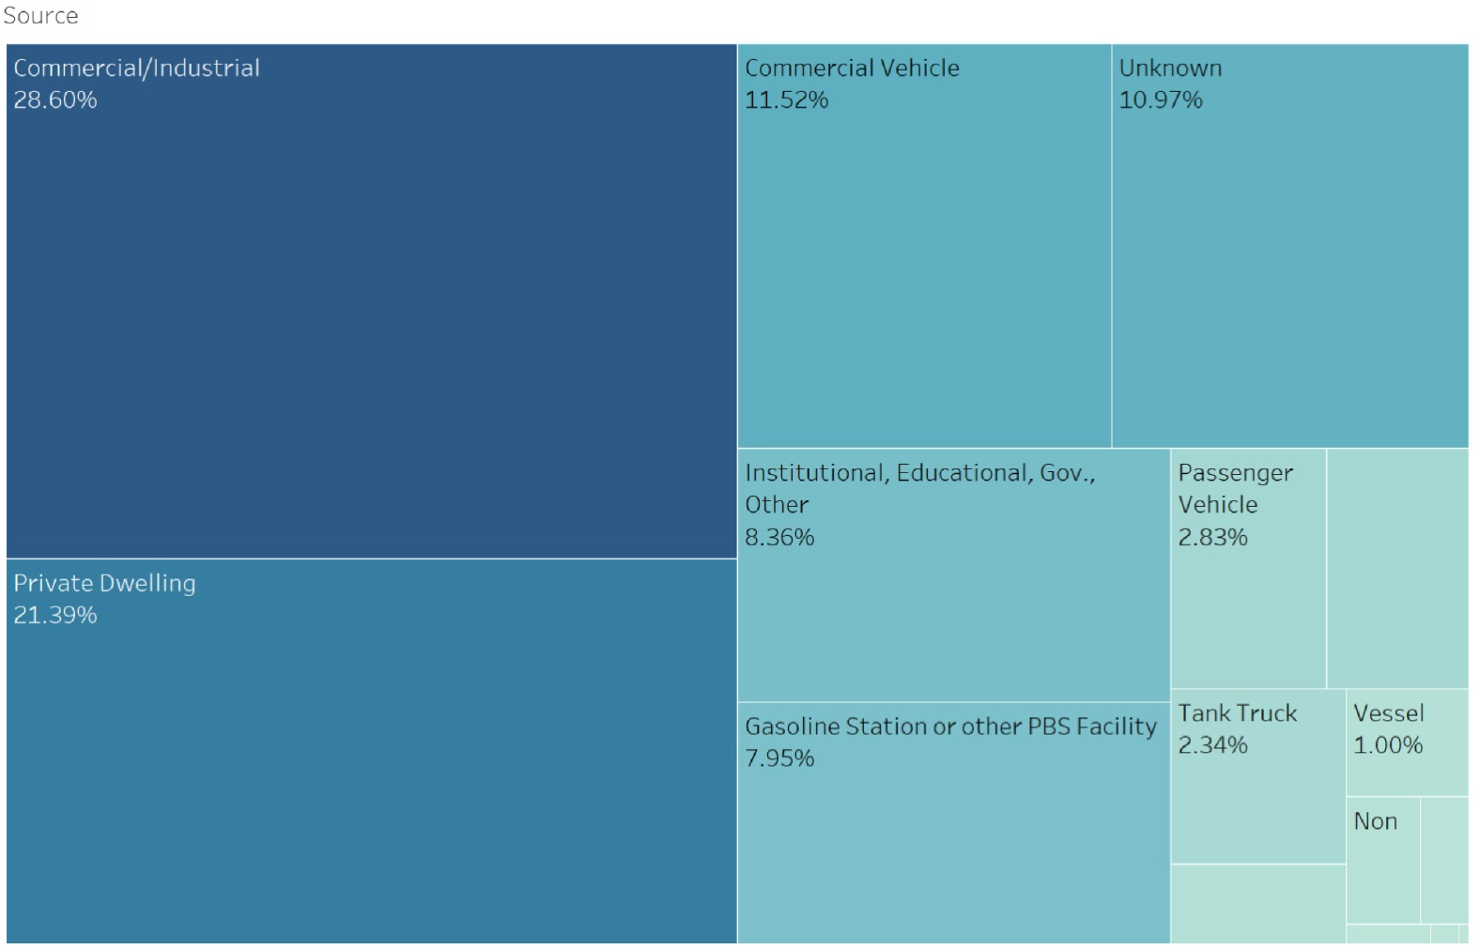
Data visualization and deliverables
Cause of spill
Source of spill
Equipment failure is the major cause of spill and accounts for 37% of the total spill occurrences
The cause of spill is unknown in 18%(appx) of the incidents
Commercial/Industrial facilities and private dwellings are the major sources and responsible for 50% of the spill occurrences
The source of spill is unknown in 11%(appx) of the incidents

Slide 15
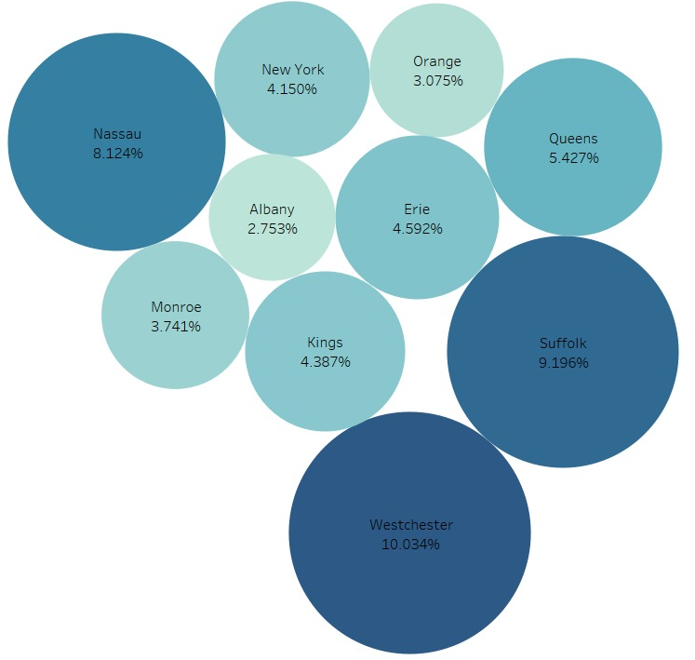
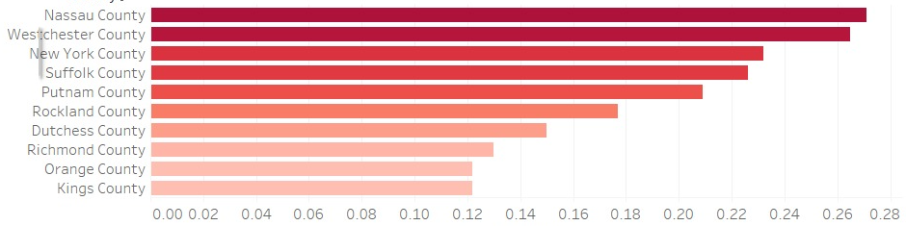
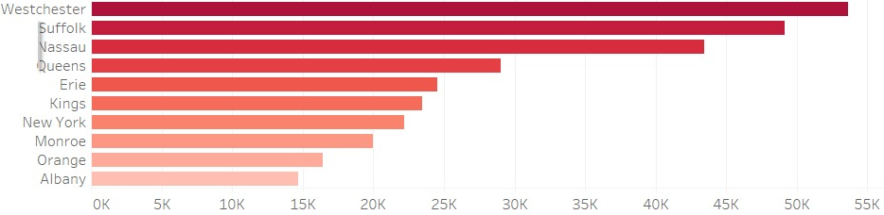
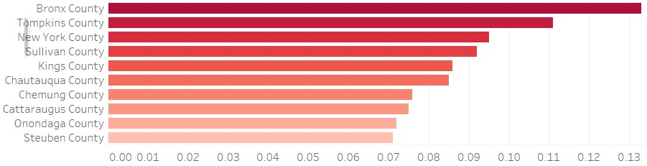
Data visualization and deliverables
County-wise analysis of the relationship between the number of spill occurrences and the income level of people
Top 10 counties
County
10 counties account for more than 55% of the total spills
County
% of households with income $200k or more
County
Top 10 counties
Number of spills
More spills occurred in counties with more wealthy people (6 out of 10 counties match here)
Less spills occurred in counties with less wealthy people
There is no strong relationship between number of spills and the income level of people.
Our assumption is false
% of households with income $10k or less

Slide 16
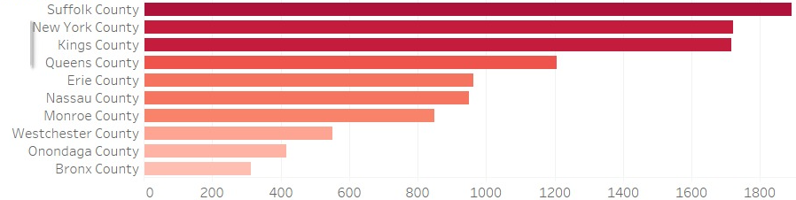
Data visualization and deliverables
County-wise analysis of the relationship between the number of spill occurrences and the number of manufacturing firms
County
Top 10 counties
Top 10 counties
County
Number of manufacturing establishments
Number of spills
More spills occurred in counties with a greater number of manufacturing establishments
Our assumption is true

Slide 17





Project Milestones & Timeline
04-03-2023
05-03-2023
Planning
Present initial project proposal
Modify the proposal
Collect required datasets
Assign roles and responsibilities with due dates
Data model
Develop conceptual data model
Develop physical data model
Deliver & Present
Present final solution to class
Determine peer score
Analysis
Data profiling in Python
EDA & Data visualization
EDA in python
Data visualization in Tableau
03-05-2023
04-23-2023
05-12-2023

Slide 18
Team Responsibilities
Lakshmikar Reddy Polamreddy
GROUP 7
Project management and planning
To gather datasets and prepare project proposal
Data profiling, EDA and Data visualization in Python and Tableau
To prepare final reports and slide deck
Banty Phagotra
Sandeep
To support in preparing project proposal
To develop conceptual and physical data model
To create OLTP and OLAP databases in AWS
ETL process
Data visualization in Tableau

Slide 19

Assumptions
1
3
We assume that more spill incidents occur in counties where the income level of people is less
We assume that the number of manufacturing establishments increase in the same proportion as that of 2017
2
4
We assume that more spill incidents occur in counties with large number of industrial establishments
We assume that there is negligible change in the medium income of the households from 2021

Slide 20

Challenges
Granularity of spills dataset(incident-wise) and income and manufacturing datasets (county-wise) are different, we could not integrate the latter dataset with the former in star schema. So, we handle them separately for analysis and visualization
Created OLTP model in AWS but found challenging to create OLAP model using AWS Glue
Faced challenges to find the relationship between spill incidents and income details under various categories

Slide 21
Thank you!

